Slide 1
Servlet

Slide 2
CGI
CGI (Common Gateway Interface) is used to provide dynamic content to the user.
CGI is used to execute a program that resides in the server to process data or access databases to produce the relevant dynamic content.
Programs that resides in server can be written in native operating system such as C++.

Slide 3
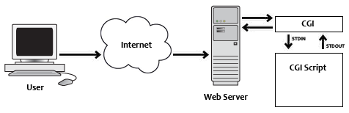
Diagrammatic Representation

Slide 4
Disadvantages Of CGI
For each request CGI Server receives, It creates new Operating System Process.
If the number of requests from the client increases then more time it will take to respond to the request.
As programs executed by CGI Script are written in the native languages such as C, C++, perl which are platform independent.

Slide 5
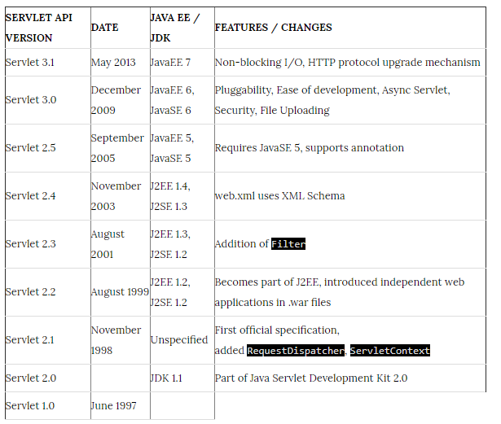
Servlet API History

Slide 6
What is Servlet ?
Servlets are an important component of a J2EE application. Servlets along with JavaServer Pages (JSP) and EJB modules can be termed as server-side J2EE component types.
Servlet is a Java Programming Language.
Servlets are used to create web applications.
Servlets are used to extend the applications hosted by web servers. Servlet runs in a J2EE application server.

Slide 7
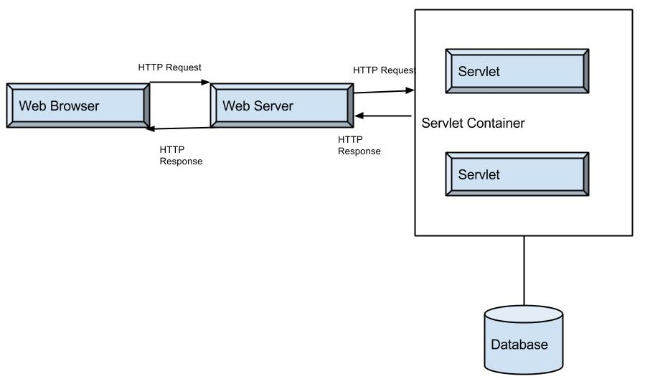
Servlet Architecture

Slide 8
Process can be summarized
A client sends a request to a Web Server, through a Web Browser.
The Web Server searches for the required Servlet and initiates it.
The Servlet then processes the client request and sends the response back to the server, which is then forwarded to the client.

Slide 9
Advantages
Servlets provide component based and platform-independent methods for building Web based applications.
Each Request is run in a separate thread ,so servlet request processing is faster than CGI.
Servlets overcomes the limitations of CGI program.
Servlets run on Java Virtual Machine and in any platform and it is simple to write.
Servlet are more powerful and the performance is better.

Slide 10
Advantages(Contd...)
Servlets are platform-independent.
Servlet technology, in addition to improved performance, offers security, robustness, object orientation, and platform independence.
As mentioned in the definition of servlets are fully integrated with the Java language and its standard APIs. Hence JDBC for Java database connectivity is also integrated in it.
A servlet handles concurrent requests
Handling HTTP requests and send text and data back to the client is made easy by servlet request and response objects.

Slide 11
Disadvantages of a Servlet
Servlets often contain both business logic and presentation logic so it makes application difficult to understand.
You would need JRE to be installed to run a servlet program.

Slide 12
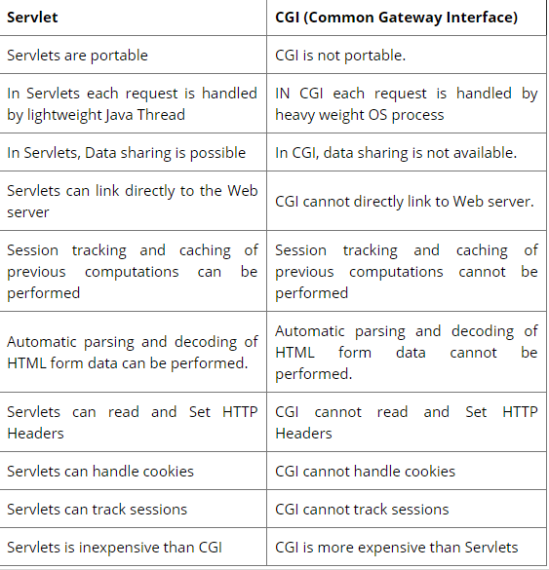
Servlet vs CGI

Slide 13
Servlet API
Servlet API is supported by all Servlet containers, such as Tomcat and Weblogic, etc. The Application Programming Interface (API) contains interface and classes to write a servlet program. The servlet API contains two packages as listed below:
javax.servlet
javax.servlet.http

Slide 14
Servlet LifeCycle
Servlets are small programs that run at server side and creates dynamic web pages. Servlets respond to any type of requests sent by user. In MVC architecture servlet act as controller. The controller is the logic that processes and responds to the user requests.
Life Cycle of Servlets contain following steps:
Load servlet class.(1)
Create servlet instance.(2)
Call the init method.(3)
Call the service method.(4)
Call the destroy method.(5)

Slide 15
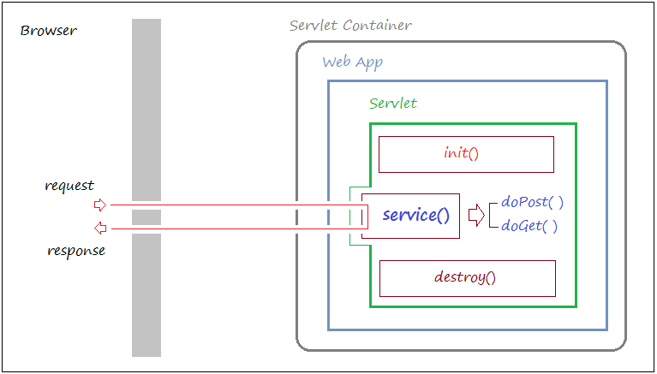
Servlet LifeCycle

Slide 16
Servlet Class Loading(1)
The first step in creation of a servlet component is to load the servlet class file into web container’s JVM (Java Virtual Machine). This step is invoked when either first time servlet is invoked or configured in the web.xml with load-on-startup element.

Slide 17
Creating Servlet Instance(2)
After the servlet class has been loaded into the web container’s JVM, the next step is to create an instance of that class. Servlet specification declares one and only one servlet instance will be created for a single definition in the deployment descriptor.

Slide 18
init () method(3)
After servlet instance is created, the web container initializes the parameters that were specified in the deployment descriptor. This method is invoked only when servlet is first loaded into memory. The syntax of init () method look like this:
public void init () throws Servlet Exception { //code }

Slide 19
Service method(4)
After the servlet component has been initialized, the web container can begin sending requests to that component using the service method .This method is used to process the request. For each request the web container will issue unique request and response to the service method. The syntax of service () method as follows:
public void service (Servletrequest request, Servletresponse response) throws ServletException, IOException { }

Slide 20
Service method(4)..(Contd..)
When service () method is called by web container it invokes doGet (), doPost (), doPut (), doDelete (), doTrace (), doOptions (), getLastModified () methods.
The doGet () and doPost () are the two methods which are frequently used with each service request. We must override doGet () and doPost () methods depending on type of request.

Slide 21
4.1
The doGet () method: By using doGet () method we can send specific amount of data. If we use doGet () method data is shown in address bar. We must override doGet () method depending on type of request. It can be defined as follows:
public void doGet (HttpServletRequest request, HttpServletResponse response)
throws ServletException, IOException{
//code
}

Slide 22
4.2
The doPost () method: We can send large amount of data by using doPost () method. By using this method data is not viewable in address bar. When we want to send secure data like passwords and other things doPost () method is used. We must override doPost () method depending on type of request. It can be defined as follows:
public void doPost (HttpServletRequest request, HttpServletResponse response)
throws ServletException, IOException{
//code
}

Slide 23
4.3
doDelete (): It is used to delete files, web pages or documents from the server. If requests are formatted incorrectly then it will return HTTP “Bad Request” error. It can be defined as follows:
protected void doDelete (HttpServletRequest request, HttpServletResponse response)
throws ServletException, IOException{
//code
}

Slide 24
4.4
doPut() : This method is used to put files, web pages or documents in the server means for uploading files on the server. If requests are formatted incorrectly then it will return HTTP “Bad Request” error. It can be defined as follows:
protected void doPut (HttpServletRequest request, HttpServletResponse response)
throws ServletException, IOException{
//code
}

Slide 25
4.5
doTrace () : This method is used for logging and debugging purpose. It can be used for testing the requested message. There is no need to override this method. It can be defined as follows:
protected void doTrace(HttpServletRequest request, HttpServletResponse response)
throws ServletException, IOException{
//code
}

Slide 26
4.6
doOptions (): This method handles OPTIONS request. There is no need to override this method. It determines which HTTP method supported by server and returns correct header. If requests are formatted incorrectly then it will return HTTP “Bad Request” error.
It can be defined as follows:
protected void doOptions(HttpServletRequest request, HttpServletResponse response)
throws ServletException, IOException{
//code
}

Slide 27
4.7
getLastModified (): It returns the time when request was last modified. This method should override GET request to return modification time of object.
It can be defined as follows:
protected long getLastModified (HttpServletRequest request)
throws ServletException, IOException{
//code
}

Slide 28
4.8
The destroy () method
When a web application is being shut down web container will call destroy method. It is used to clean up any resources that servlet might have initialized. The syntax of destroy () method as follows:
public void destroy(){
//code
}

Slide 29
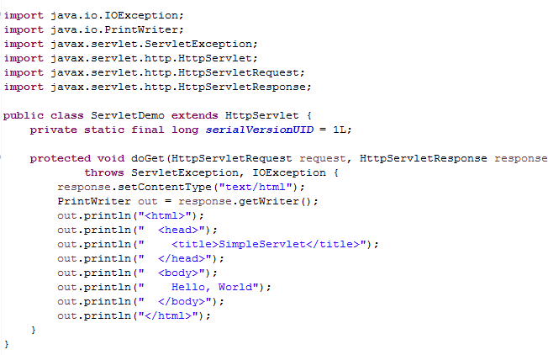
Example(ServletDemo.java)

Slide 30
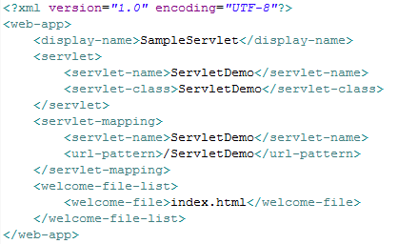
Example(Web.xml)

Slide 31
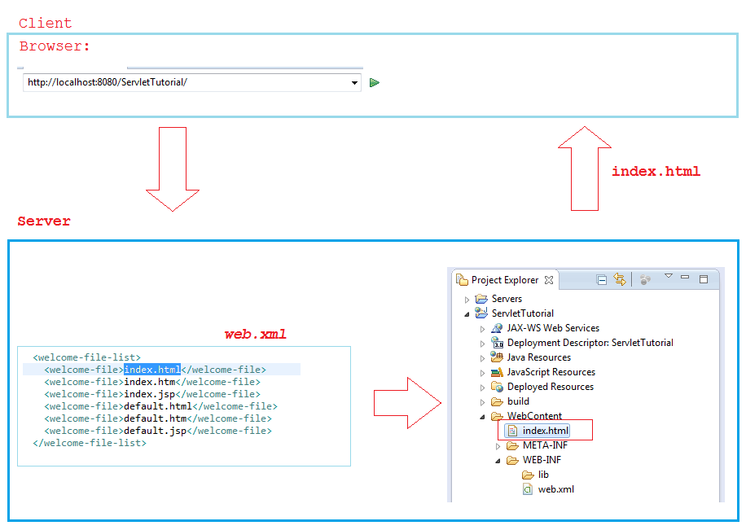
Example Step- by-Step

Slide 32
Generic Servlet and Http Servlet

Slide 33
Generic Servlet
GenericServlet is an abstract class defined in the Servlet API. For implementing class we need to implement all the methods in javax.servlet.Servlet Interface. Most of the Servlet objects do not need initializing and destroying operations but still we need to implement all the methods in javax.servlet.Servlet interface. To solve this problem, Servlet API provides javax.servlet.GenericServlet which implements ServletConfiginterface and provides the implementation for the methods in this interface except the service method.

Slide 34
Methods of GenericServlet class
public void init (): This method is invoked by init (ServletConfig) method of GenericServlet. It is used to provide custom initializations without disturbing the initializations performed by GenericServlet in the init (ServletConfig) method.
public void init (ServletConfig) : It is used to initialize the servlet. It indicates Servlet instance in being placed into the service.
public abstract void service (ServletRequest request, ServletResponse response) : It is used to process user request. It is called by servlet container to intimate servlet about client request. It carries out single request from the client. ServletRequest object is used to collect data which is available with client requested data. ServletResponse object is used to generate the output content.
public void destroy (): It indicates servlet instance is being taken out of service. It is used to clean up any resources that servlet might have initialized.
public ServletConfig getServletConfig (): It returns ServletConfig interface reference. It is used to get configuration information from web.xml file.

Slide 35
Methods of GenericServlet class
public ServletContext getServletContext (): It returns ServletContext object reference. It is used to get configuration information from web.xml file. It is also used to set, get or remove attribute from web.xml file. If information is changed then there is no need to modify the servlet. So it is easy to maintain.
public String getInitParameter (String name): It returns the Servlet initialization parameter of the given name and if requested parameter is not available then it returns null.
public Enumeration String getInitParameternames (): It returns names of all Servlet initialization parameters defined in web.xml file.
public String getServletInfo (): It returns information about the respective servlet. For e.g. version, copyright.
public String getServletName (): It returns the Servlet instance name defined in Deployment Descriptor (web.xml).
public void log (String msg): It writes class name of servlet and specified message to a servlet log file.
public void log (String msg, Throwable t): It writes explanatory message and stack trace for a given Throwable exception to the servlet log file.

Slide 36
Methods of HttpServlet class
public void service (ServletRequest request, ServletResponse response): This method is used to process the user request. For each request the web container will issue unique request and response to the service method.
public void service (HttpServletRequest request, HttpServletResponse response):This method receives requests from the service () method. It dispatches requests depending on the request type.
protected void doGet (HttpServletRequest request, HttpServletResponse response): By using doGet () method we can send specific amount of data. If we use doGet () method data is shown in address bar. We must override doGet () method depending on type of request.
protected void doPost (HttpServletRequest request, HttpServletResponse response): We can send large amount of data by using doPost () method. By using this method data is not viewable in address bar. When we want to send secure data like passwords and other things doPost () method is used. We must override doPost () method depending on type of request.

Slide 37
Methods of HttpServlet class
protected void doDelete (HttpServletRequest request, HttpServletResponse response): It is used to delete files, web pages or documents from the server. If requests are formatted incorrectly then it will return HTTP “Bad Request” error.
protected void doPut (HttpServletRequest request, HttpServletResponse response): This method is used to put files, web pages or documents in the server means for uploading files on the server. If requests are formatted incorrectly then it will return HTTP “Bad Request” error.
protected void doTrace (HttpServletRequest request, HttpServletResponse response): This method is used for logging and debugging purpose. It can be used for testing the requested message. There is no need to override this method.

Slide 38
Methods of HttpServlet class
protected void doOptions (HttpServletRequest request, HttpServletResponse response): This method handles OPTIONS request. There is no need to override this method. It determines which HTTP method supported by server and returns correct header.
protected long getLastModified (HttpServletRequest request, HttpServletResponse response): It returns the time when request was last modified. This method should override GET request to return modification time of object.
protected void doHead (HttpServletRequest request, HttpServletResponse response): This method request header part of the GET request without the GET response body. It receives request from service method and handles the request. If HEAD requests are formatted incorrectly then it will return HTTP “Bad Request” error.

Slide 39
Example for Servlet

Slide 40
Web.xml
Web.xml defines mapping between URL paths and servlets that handle requests with those paths.
The web.xml file provides configuration and deployment deployment information for the Web components that comprise a Web application.
The web.xmldescriptor files represents the core of the java application. The web.xml file is located in WEB-INF directory of web application.

Slide 41
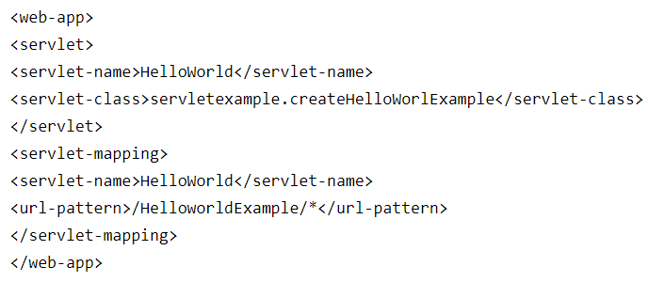
Example

Slide 42
Elements in Web.xml
<web-aap>: This element represents whole application of web.xml file
<servlet>: This is the sub element of and represents the servlet
<servlet-name>: This is the sub element of servlet and used to represents the name of servlet
<servlet-class>: This is the sub element of servlet and used to represents the class of servlet
<servlet-mapping>: This is the sub element of and used to map the servlet
<url-pattern>: This is the sub element of servlet-mapping and used to client side to invoke the servlet

Slide 43
Web.xml Tags
Welcome-file-list tag; This tag is used to specify the default page of web application if none is specified.
<welcome-file-list>
<welcome-file>index.jsp</welcome-file>
</welcome-file-list>
In the above example index.jsp used as web page for web application

Slide 44
Web.xml Tags
Error page tag: This tag is used to specify the error occurred in the while weblogic server is responding ti a HTTP request, returns an HTML page that displays either the HTTP error code.
<error-page>
<error-code>105</error-code>
<location>/jsp/error/PageNotFound.jsp</location>
</error page>

Slide 45
Web.xml Tags
Session config tag: This tag is used to specify the session configuration parameter
Example:
<session-config>
<session-timeout>
15
</session-timeout>
</session-config>
In the above example session-config tag contains another tag session-timeout which specifies the http session timeout. The time specify in minutes.

Slide 46
Advantages of web.xml file
The first benefit of the xml is we can write it in our won markup language. There is a no restricted to limited sets of tags. By defining our own tag we can create a markup language in terms of specific problem.
Searching the data is easy and efficient.
Completely compatible with Java™ and 100% portable.

Slide 47
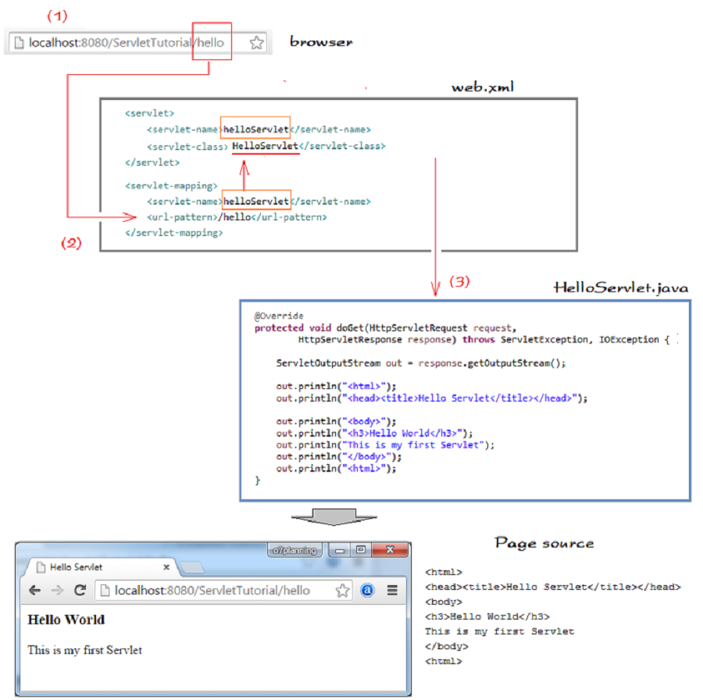
Simple Hello World

